Slide 1



OPOSEC
OSINT
PRIVATE BUSINESS, PUBLIC FALLOUT
Private Business, Public Fallout
How OSINT Took Down Portugal's Government
How to obtain the public information behind the recent scandal involving the Portuguese prime minister that led to the downfall of the government.

Slide 2




OPOSEC
OSINT
PRIVATE BUSINESS, PUBLIC FALLOUT
Disclaimer & Legal Considerations
Presentation is solely for educational and awareness purposes.
Not a political statement.
Users must check the legality of OSINT tools and methods in their country.
This presentation is not related to my work or employer.
Page 01

Slide 3
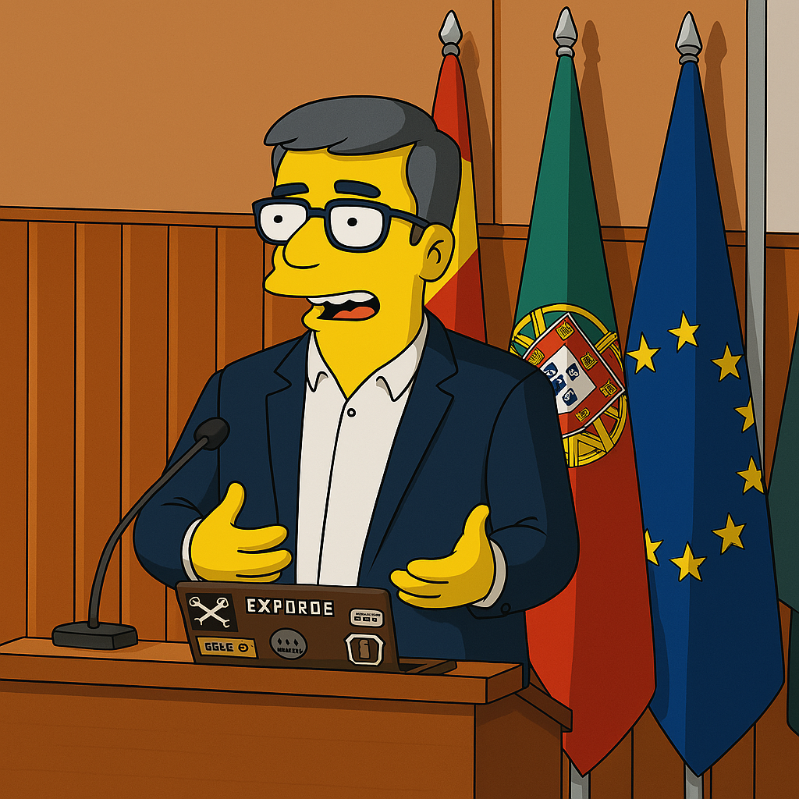
OPOSEC
OSINT
PRIVATE BUSINESS, PUBLIC FALLOUT
$whoami
👓 Pedro Vieira
🔐 Cybersecurity Engineer
🕵️ OSINT
✒️ Full stack developer
👨‍🏫 Public Speaker
Page 02

Slide 4
OPOSEC
OSINT
PRIVATE BUSINESS, PUBLIC FALLOUT
Agenda
OSINT
Future
Portuguese Prime Minister
Page 03

Slide 5

OPOSEC
OSINT
PRIVATE BUSINESS, PUBLIC FALLOUT
OSINT
Page 4

Slide 6

OPOSEC
OSINT
PRIVATE BUSINESS, PUBLIC FALLOUT
OSINT
Open-source intelligence (OSINT) is the collection and analysis of data gathered from open sources (overt and publicly available sources) to produce actionable intelligence. (Wikipedia)
Gathering information from:
government sites
search engines (Google, …)
social media (Facebook, …)
maps
…
And then extract/relate/infer new information with greater value/potential
Page 05

Slide 7
OPOSEC
OSINT
PRIVATE BUSINESS, PUBLIC FALLOUT
Prime Minister
Page 06

Slide 8
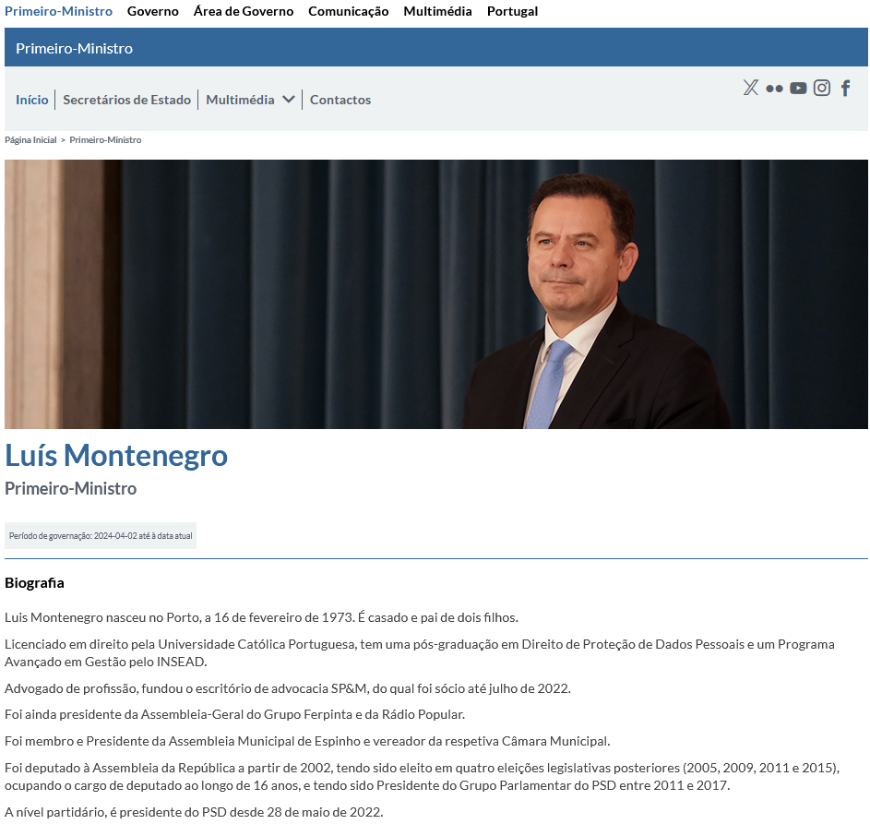

OPOSEC
OSINT
PRIVATE BUSINESS, PUBLIC FALLOUT
Portal do Governo
Hint: Previous governments, ministers, ...
Page 07

Slide 9
OPOSEC
OSINT
PRIVATE BUSINESS, PUBLIC FALLOUT
Status
Name: Luís Montenegro
Birth: 16/02/1973 - Porto
Marital Status:
Married
2 children
Education:
Law graduate - Universidade Católica Portuguesa - 1999
Post-graduate degree in Personal Data Protection - INSEAD
Advanced Management Programme - INSEAD
Previous Job:
Lawyer – Founder and Partner of SP&M law firm
Chairman of the General Meeting of the Ferpinta Group
Chairman of the General Meeting of Rádio Popular
Politician:
Member and Chairman of the Espinho Municipal Assembly and Councillor
Member of Parliament in 2002, 2005, 2009, 2011, and 2015 (16 years)
President of the PSD Parliamentary Group from 2011 to 2017
Leader of the Social Democrats (PSD) since 28 May 2022
Page 08

Slide 10
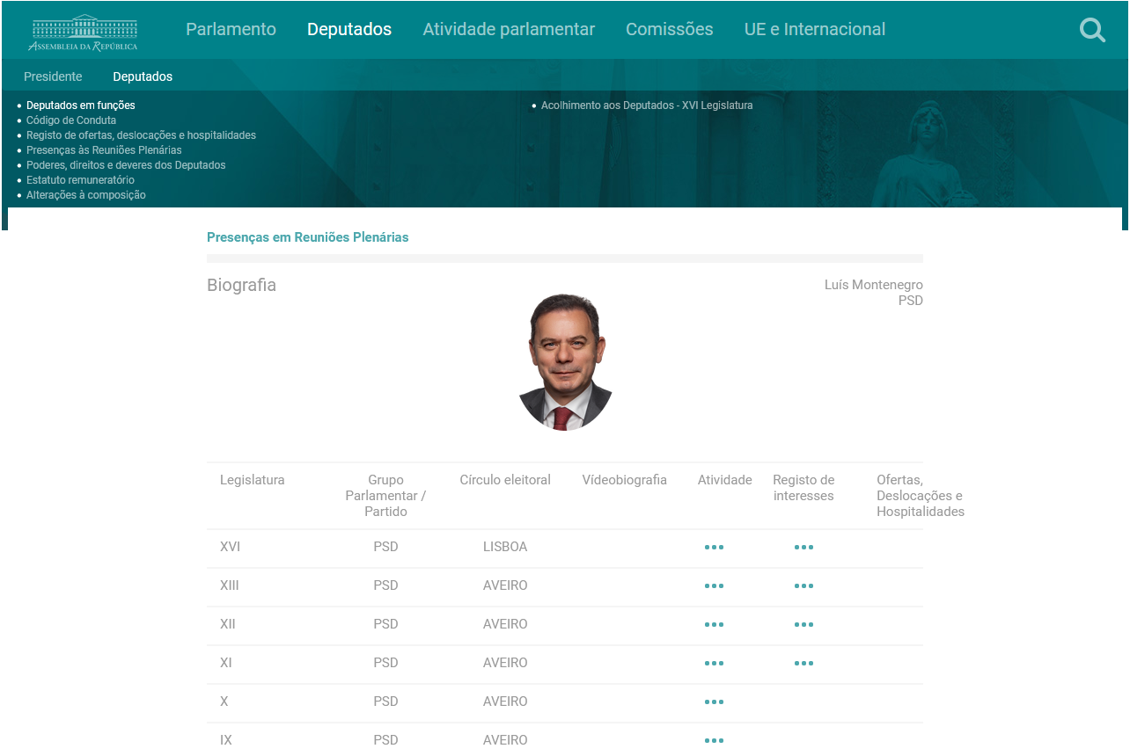

OPOSEC
OSINT
PRIVATE BUSINESS, PUBLIC FALLOUT
Portal da Assembleia da República
Hint: Registration of interests
Page 09

Slide 11
OPOSEC
OSINT
PRIVATE BUSINESS, PUBLIC FALLOUT
Status
Name: Luís Montenegro
Full Name: Luís Filipe Montenegro Cardoso de Morais Esteves
Birth: 16/02/1973 - Porto
Marital Status:
Married - Carla Maria Rodrigues Neto Montenegro
Comunhão de Adquiridos
2 children
Education:
Law graduate - Universidade Católica Portuguesa - 1999
Post-graduate degree in Personal Data Protection - INSEAD
Advanced Management Programme - INSEAD
Previous Job:
Lawyer – Founder and Partner of SP&M law firm - Porto (50%)
Chairman of the General Meeting of the Ferpinta Group
Chairman of the General Meeting of Rádio Popular
Oliveiras Gold de Portugal, Lda (25%) - Bragança
Luimonteago, Lda (95%) - Barcelos
Politician:
Member and Chairman of the Espinho Municipal Assembly and Councillor
Member of Parliament in 2002, 2005, 2009, 2011, and 2015 (16 years)
President of the PSD Parliamentary Group from 2011 to 2017
Leader of the Social Democrats (PSD) since 28 May 2022
Page 10

Slide 12
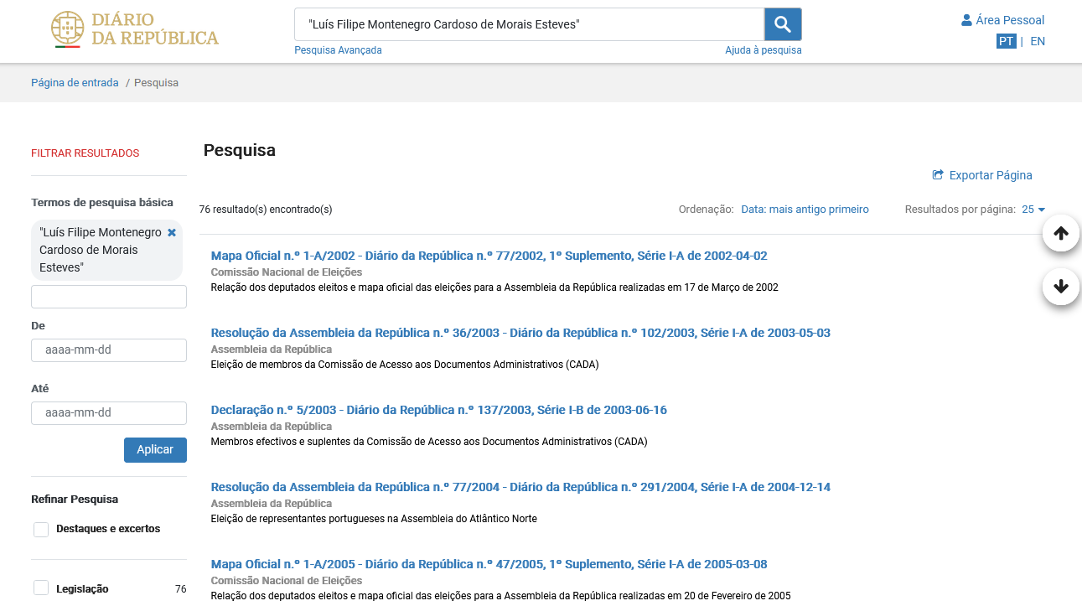

OPOSEC
OSINT
PRIVATE BUSINESS, PUBLIC FALLOUT
Diário da República Eletrónico
Page 11

Slide 13
OPOSEC
OSINT
PRIVATE BUSINESS, PUBLIC FALLOUT
Companies
SP&M, Sociedade de Advogados, RL - 510445020
Luimonteago, Lda - 510347070
Oliveiras Gold de Portugal, Lda - 510172466
Grupo Ferpinta, SA - 501756710
Radio Popular - Eletrodomésticos, SA - 500674205
Page 12

Slide 14
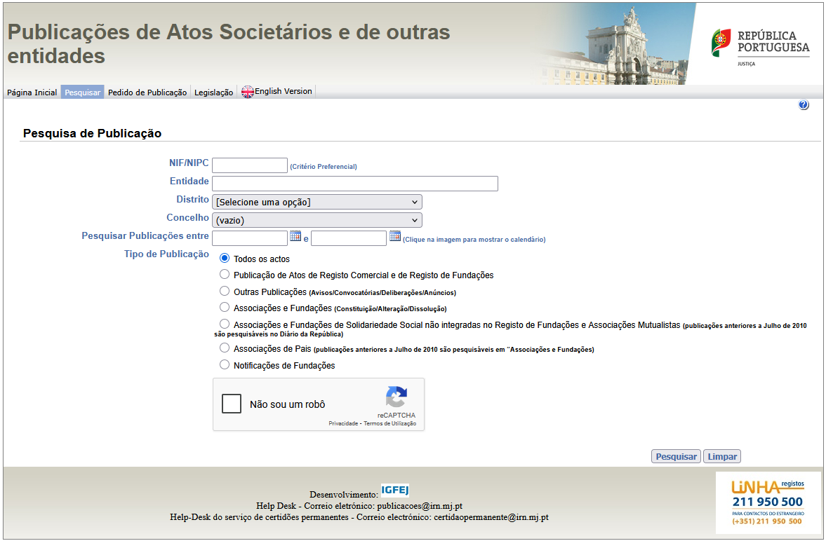

OPOSEC
OSINT
PRIVATE BUSINESS, PUBLIC FALLOUT
Ministério da Justiça – Publicação de Atos Societários
Page 13

Slide 15
OPOSEC
OSINT
PRIVATE BUSINESS, PUBLIC FALLOUT
SP&M, Sociedade de Advogados, RL - 510445020
Page 14

Slide 16
OPOSEC
OSINT
PRIVATE BUSINESS, PUBLIC FALLOUT
Status
Name: Luís Montenegro
Full Name: Luís Filipe Montenegro Cardoso de Morais Esteves
NIF: 205910254
Birth: 16/02/1973 - Porto
Marital Status:
Married - Carla Maria Rodrigues Neto Montenegro
Comunhão de Adquiridos
2 children
Address:
Urbanização do Formal, nº 15
4500 - 669 Silvalde - Espinho
Education:
Law graduate - Universidade Católica Portuguesa - 1999
Post-graduate degree in Personal Data Protection - INSEAD
Advanced Management Programme - INSEAD
Previous Job:
Lawyer – Founder and Partner of SP&M law firm - Porto (50%)
Chairman of the General Meeting of the Ferpinta Group
Chairman of the General Meeting of Rádio Popular
Oliveiras Gold de Portugal, Lda (25%) - Bragança
Luimonteago, Lda (95%) - Barcelos
Politician:
Member and Chairman of the Espinho Municipal Assembly and Councillor
Member of Parliament in 2002, 2005, 2009, 2011, and 2015 (16 years)
President of the PSD Parliamentary Group from 2011 to 2017
Leader of the Social Democrats (PSD) since 28 May 2022
Page 15

Slide 17
OPOSEC
OSINT
PRIVATE BUSINESS, PUBLIC FALLOUT
SP&M, Sociedade de Advogados, RL - 510445020
Site einforma (link)
NIPC: 510445020
Denominação: SOUSA PINHEIRO & MARQUES - SOCIEDADE DE ADVOGADOS, SP, RL
Designações anteriores: SOUSA PINHEIRO & MONTENEGRO - SOCIEDADE DE ADVOGADOS, SP, RL
Website: https://spm-advogados.com/
DUNS:
Morada: PRAÇA BOM SUCESSO, 74/90 3º ESCRITÓRIO 7 – 4150-146 PORTO
Telefone:
Email:
CAE: 69101 - Atividades jurídicas, exceto dos cartórios notariais
Page 16

Slide 18
OPOSEC
OSINT
PRIVATE BUSINESS, PUBLIC FALLOUT
SP&M, Sociedade de Advogados, RL - 510445020
SP&M (link)
Sócios: Paulo Sousa Pinheiro
WaybackMachine: (link)
Email: lmontenegro@spm-advogados.com
Advogado (cédula profissional n.º 44944P) – Inactivo (portal ordem dos advogados)
Deputado na Assembleia Metropolitana do Porto
Hint: Wayback everything
Page 17

Slide 19
OPOSEC
OSINT
PRIVATE BUSINESS, PUBLIC FALLOUT
Status
Name: Luís Montenegro
Full Name: Luís Filipe Montenegro Cardoso de Morais Esteves
NIF: 205910254
Birth: 16/02/1973 - Porto
Marital Status:
Married - Carla Maria Rodrigues Neto Montenegro
Comunhão de Adquiridos
2 children
Address:
Urbanização do Formal, nº 15
4500 - 669 Silvalde - Espinho
Email: lmontenegro@spm-advogados.com
Education:
Law graduate - Universidade Católica Portuguesa - 1999
Post-graduate degree in Personal Data Protection - INSEAD
Advanced Management Programme - INSEAD
Previous Job:
Lawyer - 44944P
Lawyer – Founder and Partner of SP&M law firm - Porto (50%)
Chairman of the General Meeting of the Ferpinta Group
Chairman of the General Meeting of Rádio Popular
Oliveiras Gold de Portugal, Lda (25%) - Bragança
Luimonteago, Lda (95%) - Barcelos
Politician:
Member and Chairman of the Espinho Municipal Assembly and Councillor
Member of Parliament in 2002, 2005, 2009, 2011, and 2015 (16 years)
President of the PSD Parliamentary Group from 2011 to 2017
Leader of the Social Democrats (PSD) since 28 May 2022
Page 18

Slide 20
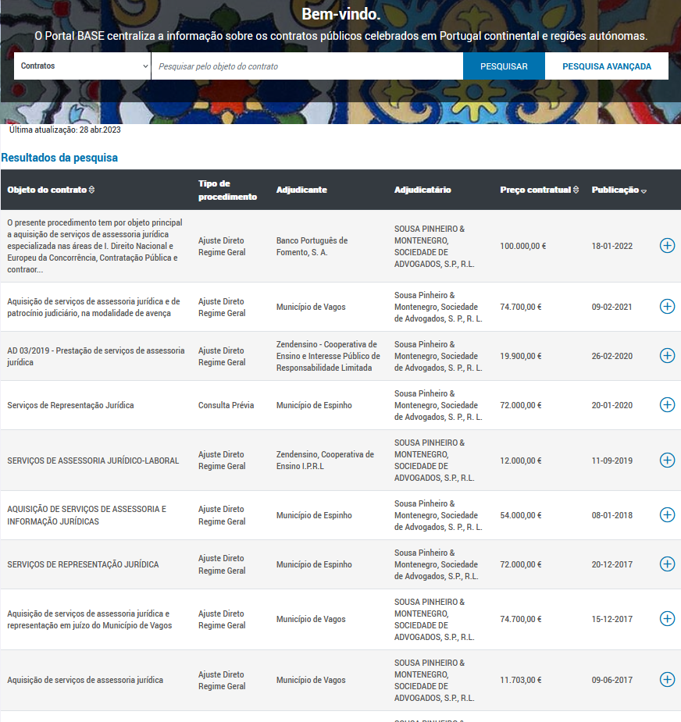

OPOSEC
OSINT
PRIVATE BUSINESS, PUBLIC FALLOUT
Portal BASE
Page 19

Slide 21
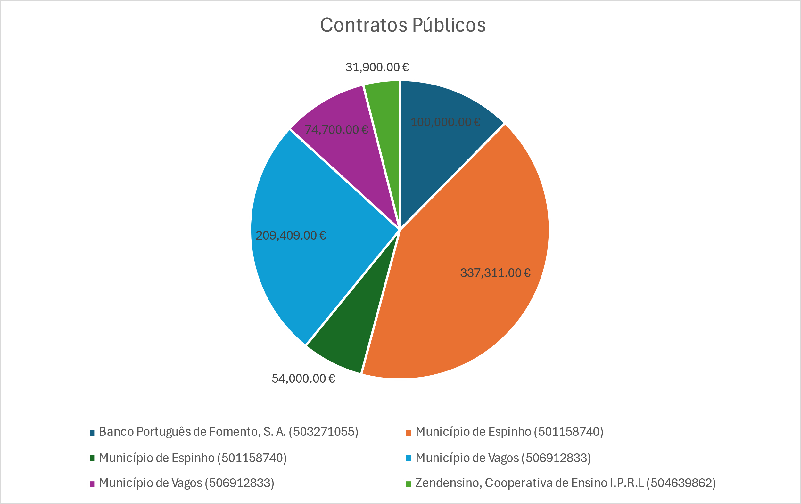
OPOSEC
OSINT
PRIVATE BUSINESS, PUBLIC FALLOUT
SP&M, Sociedade de Advogados, RL - 510445020
Contratos Públicos
Banco Português do Fomento
2022 – 1 contrato – 100.000€
Município de Espinho
2014/2019 – 7 contratos – 337.311 €
Município de Vagos
2015/2021 – 5 contratos – 209.409 €
Zendensino
2018/2020 – 2 contratos – 31.900 €
Total 807.320€
Page 20

Slide 22
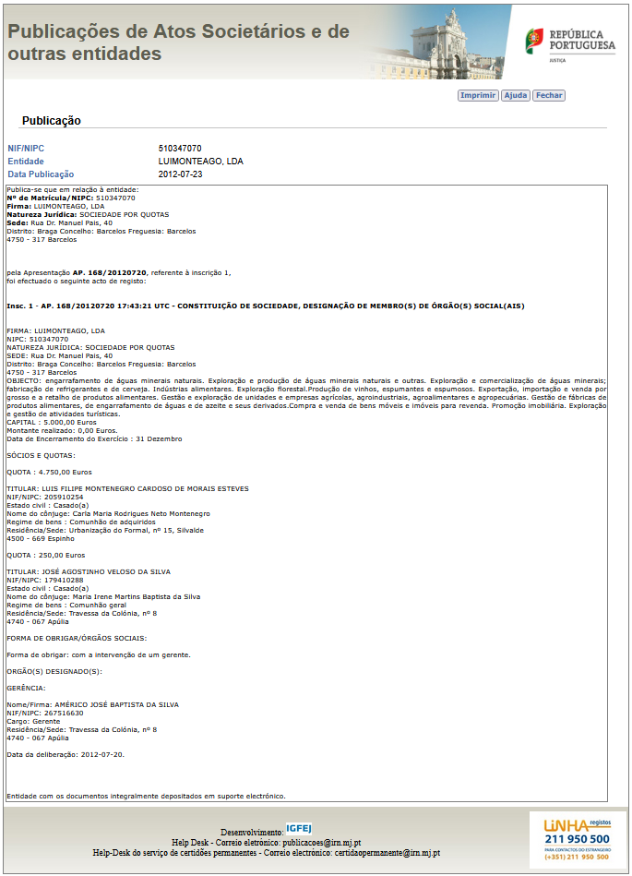
OPOSEC
OSINT
PRIVATE BUSINESS, PUBLIC FALLOUT
Luimonteago, Lda - 510347070
Page 21

Slide 23
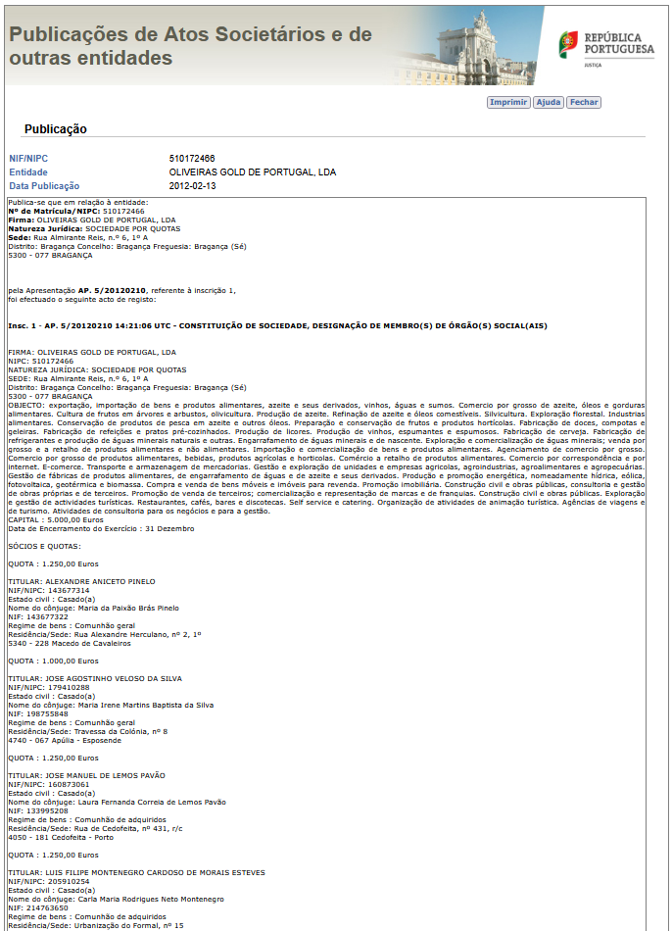
OPOSEC
OSINT
PRIVATE BUSINESS, PUBLIC FALLOUT
Oliveiras Gold de Portugal, Lda - 510172466
Page 22

Slide 24
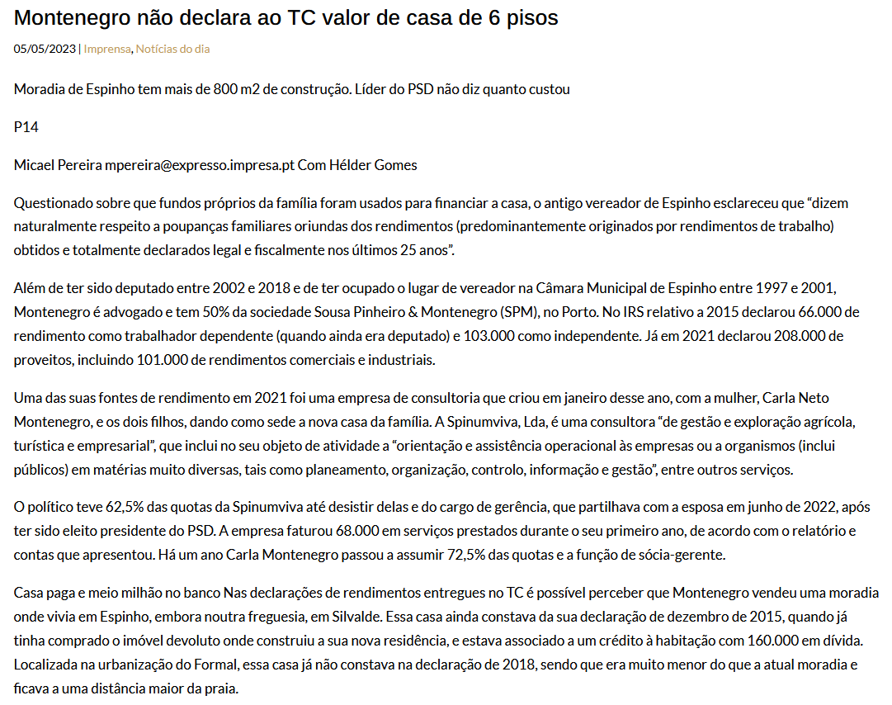
OPOSEC
OSINT
PRIVATE BUSINESS, PUBLIC FALLOUT
Semanário Expresso
Page 23

Slide 25
OPOSEC
OSINT
PRIVATE BUSINESS, PUBLIC FALLOUT
Companies
SP&M, Sociedade de Advogados, RL - 510445020
Luimonteago, Lda - 510347070
Oliveiras Gold de Portugal, Lda - 510172466
Grupo Ferpinta, SA - 501756710
Radio Popular - Eletrodomésticos, SA – 500674205
Spinumviva, Lda - 516195174
Page 24

Slide 26
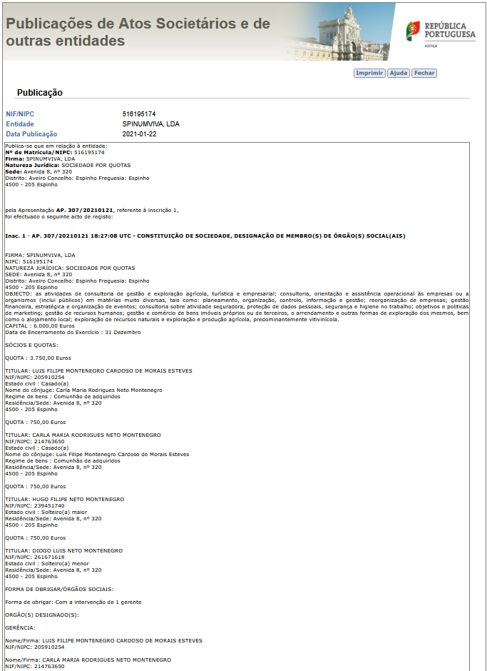
OPOSEC
OSINT
PRIVATE BUSINESS, PUBLIC FALLOUT
Spinumviva, Lda - 516195174
Page 25

Slide 27
OPOSEC
OSINT
PRIVATE BUSINESS, PUBLIC FALLOUT
Status
Name: Luís Montenegro
Full Name: Luís Filipe Montenegro Cardoso de Morais Esteves
NIF: 205910254
Birth: 16/02/1973 - Porto
Marital Status:
Married - Carla Maria Rodrigues Neto Montenegro
Comunhão de Adquiridos
Hugo Filipe Neto Montenegro
Diogo Luís Neto Montenegro
Address:
Avenida 8, nº 320
4500 - 205 Espinho
Email: lmontenegro@spm-advogados.com
Education:
Law graduate - Universidade Católica Portuguesa - 1999
Post-graduate degree in Personal Data Protection - INSEAD
Advanced Management Programme - INSEAD
Previous Job:
Lawyer - 44944P
Lawyer – Founder and Partner of SP&M law firm - Porto (50%)
Chairman of the General Meeting of the Ferpinta Group
Chairman of the General Meeting of Rádio Popular
Oliveiras Gold de Portugal, Lda (25%) - Bragança
Luimonteago, Lda (95%) - Barcelos
Politician:
Member and Chairman of the Espinho Municipal Assembly and Councillor
Member of Parliament in 2002, 2005, 2009, 2011, and 2015 (16 years)
President of the PSD Parliamentary Group from 2011 to 2017
Leader of the Social Democrats (PSD) since 28 May 2022
Page 26

Slide 28
OPOSEC
OSINT
PRIVATE BUSINESS, PUBLIC FALLOUT
Spinumviva, Lda - 516195174
2025-03-05 Cessação de funções de membro(s) do(s) orgão(s) social(ais)
2024-10-11 Prestação de contas individual - 2023
2024-05-14 Alterações ao contrato de sociedade
2023-07-13 Prestação de contas individual - 2022
2023-06-22 Designação de membro(s) de orgão(s) social(ais)
2022-09-05 Cessação de funções de membro(s) do(s) orgão(s) social(ais)
2022-07-15 Prestação de contas individual - 2021
2022-03-16 Alterações ao contrato de sociedade e designação de membro(s) de orgão(s) social(ais)
2021-01-22 Constituição de sociedade, designação de membro(s) de órgão(s) social(ais)
Page 27

Slide 29
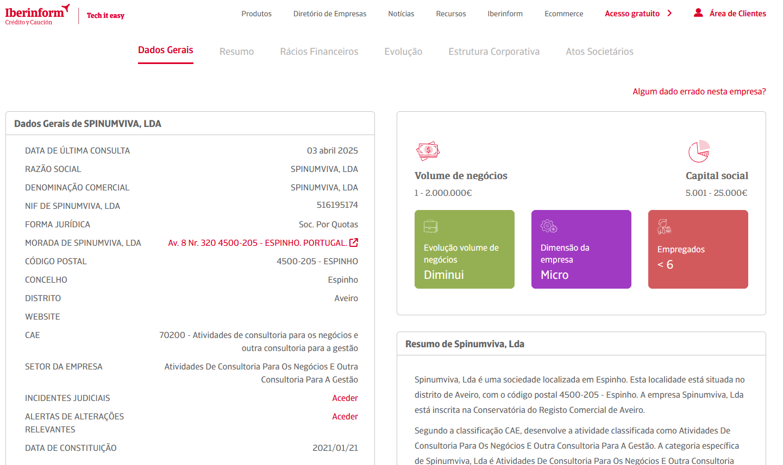
OPOSEC
OSINT
PRIVATE BUSINESS, PUBLIC FALLOUT
Spinumviva, Lda - 516195174
Page 28

Slide 30
OPOSEC
OSINT
PRIVATE BUSINESS, PUBLIC FALLOUT
Status
Name: Luís Montenegro
Full Name: Luís Filipe Montenegro Cardoso de Morais Esteves
NIF: 205910254
Birth: 16/02/1973 - Porto
Marital Status:
Married - Carla Maria Rodrigues Neto Montenegro
Comunhão de Adquiridos
Hugo Filipe Neto Montenegro
Diogo Luís Neto Montenegro
Address:
Avenida 8, nº 320
4500 - 205 Espinho
Email:
lmontenegro@spm-advogados.com
spinumviva@gmail.com
Phone:
968575793
925160873
Education:
Law graduate - Universidade Católica Portuguesa - 1999
Post-graduate degree in Personal Data Protection - INSEAD
Advanced Management Programme - INSEAD
Previous Job:
Lawyer - 44944P
Lawyer – Founder and Partner of SP&M law firm - Porto (50%)
Chairman of the General Meeting of the Ferpinta Group
Chairman of the General Meeting of Rádio Popular
Oliveiras Gold de Portugal, Lda (25%) - Bragança
Luimonteago, Lda (95%) - Barcelos
Politician:
Member and Chairman of the Espinho Municipal Assembly and Councillor
Member of Parliament in 2002, 2005, 2009, 2011, and 2015 (16 years)
President of the PSD Parliamentary Group from 2011 to 2017
Leader of the Social Democrats (PSD) since 28 May 2022
Page 29

Slide 31
OPOSEC
OSINT
PRIVATE BUSINESS, PUBLIC FALLOUT
Future / Takeaways
Page 30

Slide 32
OPOSEC
OSINT
PRIVATE BUSINESS, PUBLIC FALLOUT
Questions
How to get more info on public servants?
Tax declaration?
Wishes
Transparency on all politicians/ public serveants.
Database of companies
Multiple sources
Search by persons
Network visualization
Companies
Persons
Page 01

Slide 33


OPOSEC
OSINT
PRIVATE BUSINESS, PUBLIC FALLOUT
ARTIFICIAL
INTELLIGENCE
Use available technologies but check facts.
Always check facts.
IA is more than ChatGPT. Grok, Claude, …
Use them all.
Page 01

Slide 34

OPOSEC
OSINT
PRIVATE BUSINESS, PUBLIC FALLOUT
THANK YOU
Q&A
Page 01

Slide 35
OPOSEC
OSINT
PRIVATE BUSINESS, PUBLIC FALLOUT
LINKS
Page 01

Slide 36
OPOSEC
OSINT
PRIVATE BUSINESS, PUBLIC FALLOUT
Portal | Portal do Governo
 | Membros do Governo (link) Primeiro-Ministro (link) Redes sociais
Portal | Publicações de Atos Societários
 | Consultar e pesquisar todas as publicações (link)
https://transparencia.gov.pt/ Pesquisa de bens penhorados – não oficial (link) Pesquisa de bens penhorados – não oficial (link) https://geneall.net/ https://www.einforma.pt/ https://www.iberinform.pt https://www.racius.com https://www.rigorbiz.pt/ https://www.emailondeck.com/ https://temp-mail.org/ https://www.playmakerstats.com/ https://www.pai.pt/
Portal | Portal da Assembleia da República
 | Deputados em funções (link) Informação Pessoal (link) Registo de interesses (link) Participação em empresas (link) Dados Abertos (link)
Portal
 | Pesquisa (link) Site alternativo – DRE Tretas (link)
Portal | Portal BASE
 | O Portal BASE centraliza a informação sobre os contratos públicos (link) Contratos (link) Anúncios (link) Entidades (link) Empresas e Pessoas Indicadores (link)
Lista de subvenções e benefícios públicos e de doações (IGF) (link) Lista pública de execuções (link) Venda de Bens Penhorados em Processos Executivos (link) Lista de devedores na Segurança Social (link) Listas de Devedores na Autoridade Tributária e Aduaneira (link)
Page 01

